Slide 1
Renewable Energy Sources
composed by
Dragica Vasileska

Slide 2
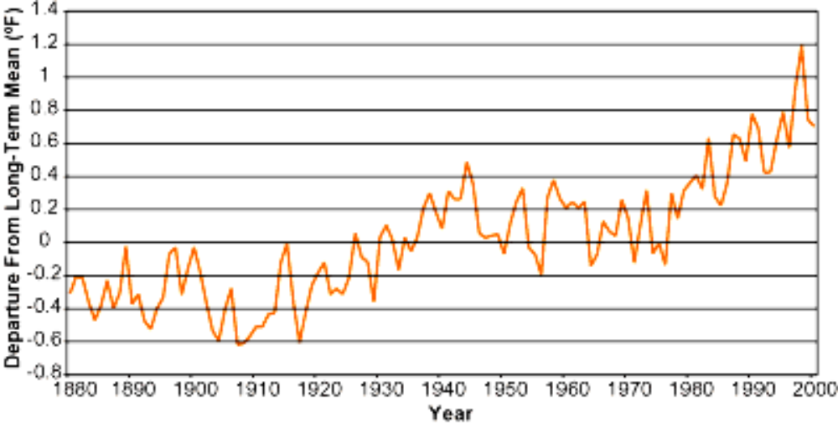
In the last 100 years, the Earth warmed up by ~1° C
100 years is nothing by geological time scales!
Notes:
Source: Steven Chu

Slide 3
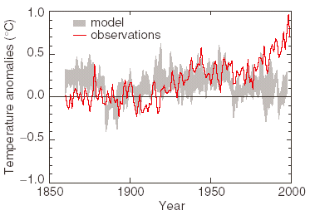
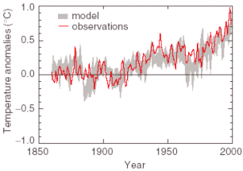
Can we predict the past?
Climate change due to natural causes (solar variations, volcanoes, etc.)
Climate change due to natural causes and human generated greenhouse gases

Slide 4
CO₂ Concentration, Temperature, and Sea Level
Continue to Rise Long after Emissions are Reduced
Sea-level rise due to ice melting: several millennia
CO₂ emissions peak
0 to 100 years
Sea-level rise due to thermal expansion:
centuries to millennia
Temperature stabilization:
a few centuries
CO₂ stabilization:
100 to 300 years
CO₂ emissions
Today
1,000 years
100 years

Slide 5
The possibility / likelihood of global warming is disturbing …
Chu
… but there may be a bigger problem!

Slide 6
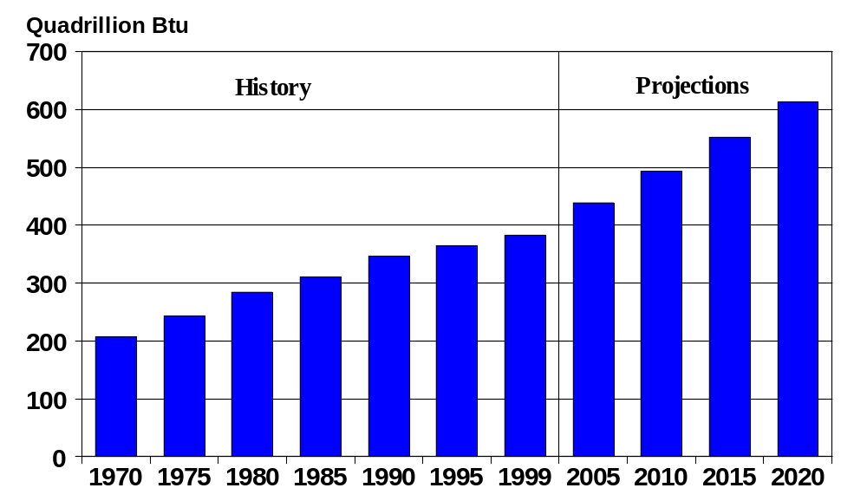
Consumption of Energy Increased by 85%
Between 1970 and 1999
By 2020, Consumption will Triple
Notes:
Source: Steven Chu

Slide 7
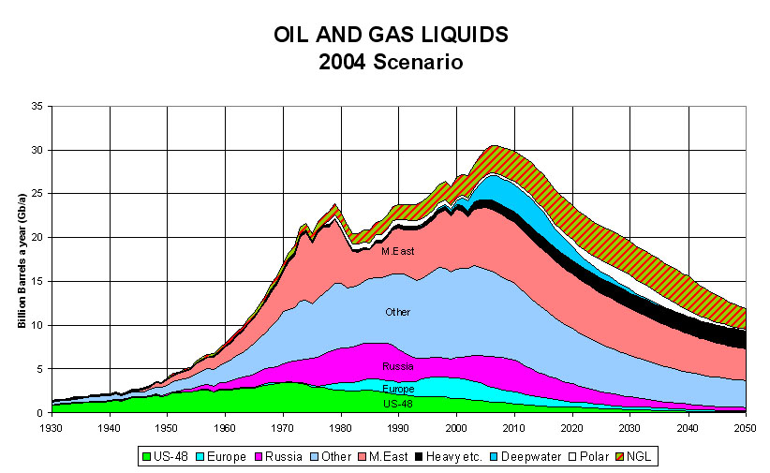
World production of oil and gas is predicted to peak within 10 - 40 years
2010

Slide 8
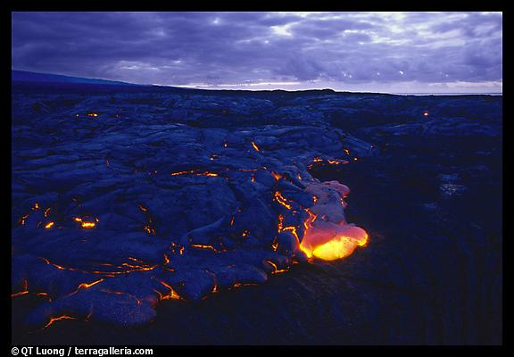
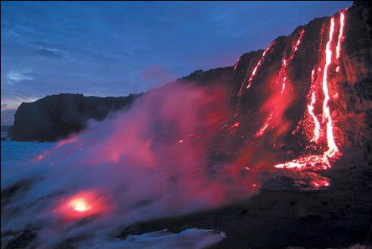
Energy conservation and
efficiency can buy time
(a factor of ~2)
but the fundamental problem remains

Slide 9
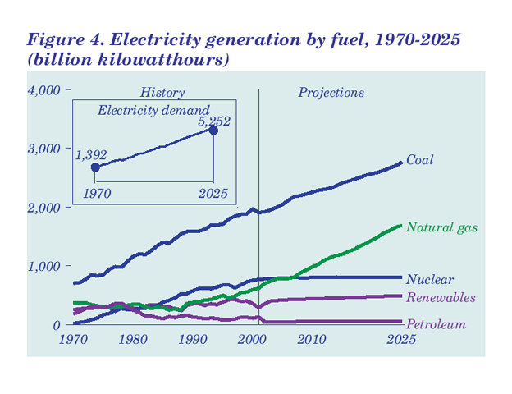

Slide 10
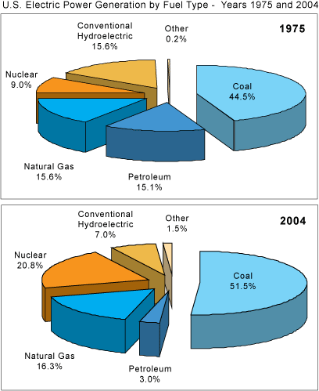
Electrical generation
Switch from petroleum to coal and natural gas
Why has hydroelectric declined?
When did nuclear go up?

Slide 11
Estimates of depletable energy resources in the U.S.
Numbers = how long it would last if all energy came from one source
Resource recoverable recoverable and hoped for
Coal 125 1300
Petroleum 5 50?
Natural gas 5 50?
Oil shale 0 2500
Conventional reactors 3 15
Breeder reactors 115 750
Fusion 10⁶ to 10⁹
Geothermal surface 0.2 60
deep rock 0 600

Slide 12
Estimates of renewable energy
Numbers = proportion of current U.S. energy needs that could be supplied for an indefinite period.
Tidal energy 0.1
Organic Waste 0.1
Photosynthesis 0.23
Hydropower 0.14
Wind Power 5
Solar radiation 740

Slide 13
Today: Production Cost of Electricity
(in the U.S. in 2002)
25-50 ¢
25
20
15
Cost, ¢/kW-hr
Cost
10
6-7 ¢
6-8 ¢
5-7 ¢
1-4 ¢
2.3-5.0 ¢
5
0
Coal
Gas
Oil
Wind
Nuclear
Solar
Courtesy Nate Lewis

Slide 14

Energy Costs
$0.05/kW-hr
Europe
Brazil
www.undp.org/seed/eap/activities/wea
Courtesy Nate Lewis

Slide 15
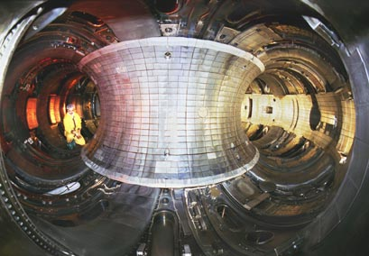
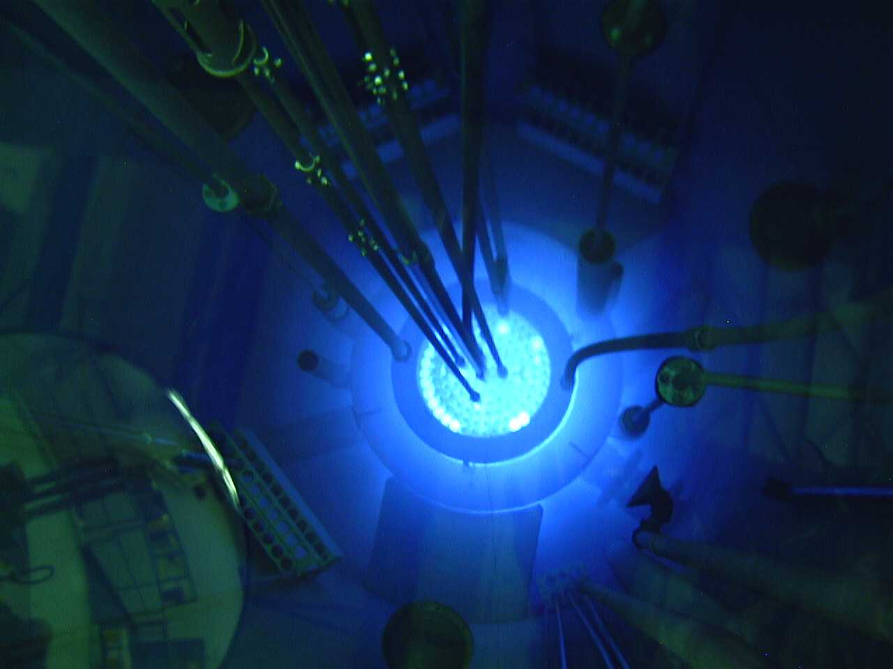
Potential Sources of Energy when
Fossil Fuels Run Out
Magnetic Plasma Confinement,
Inertial Fusion
Nuclear Fusion
Waste &
Nuclear Proliferation
Nuclear Fission
10 TW = 10,000 new 1 GW reactors: i.e., a new reactor every other day for the next 50 years

Slide 16
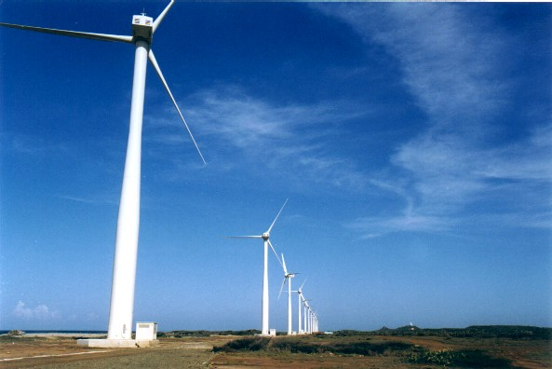
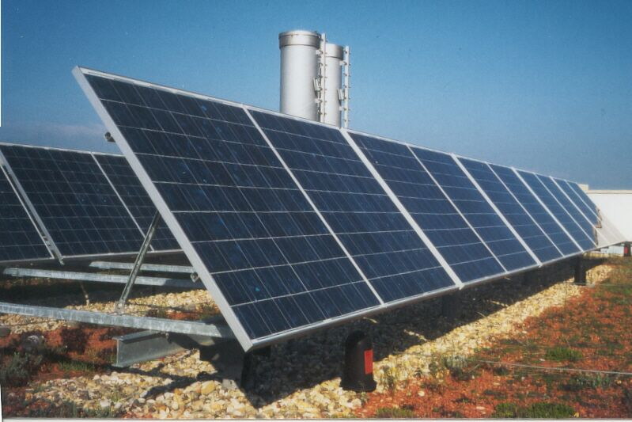
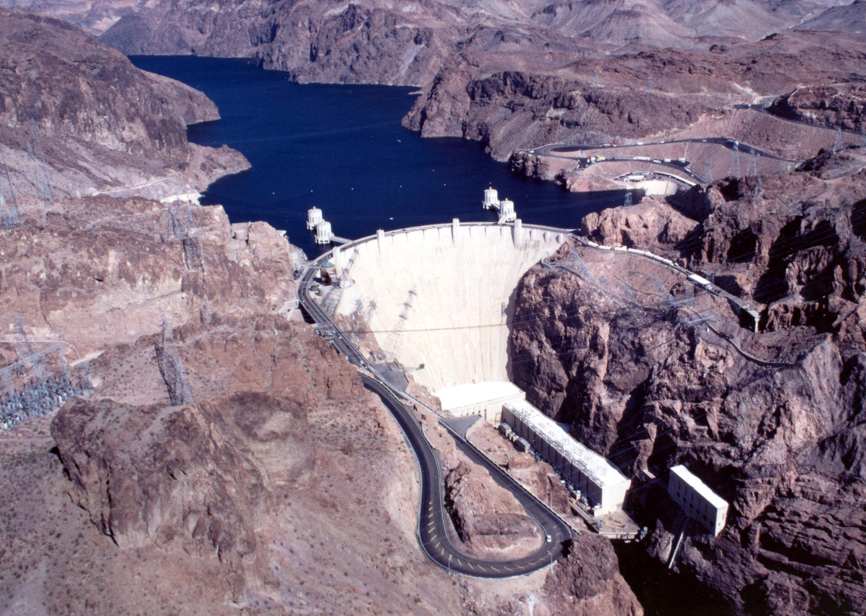
Solar, Wind and Water
We do not know how to store electrical energy on a massive scale
Notes:
Nature has been converting sunlight, CO₂ water and nutrients into chemical energy for billions of years.

Slide 17
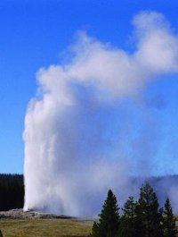
Geothermal
Heat near surface of the earth = geysers, volcanoes, hot springs

Slide 18



Solar to Chemical Energy
CO
O
H
2
2
2
e
e
Sugar
sc
M
sc
M
H O
2
H O
2
O
2
Photosynthesis
Semiconductor/
liquid junctions
Photovoltaic and
electricity to chemical

Slide 19
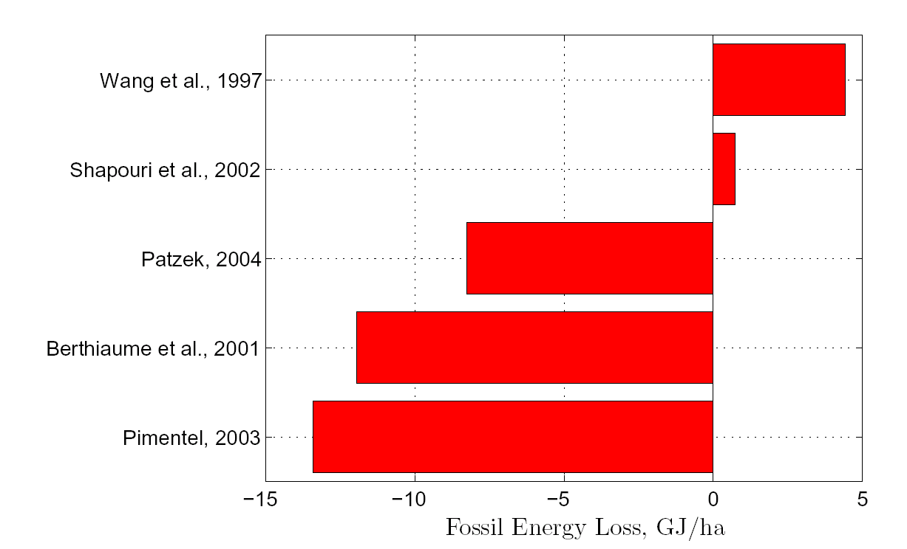
Energy gained in corn ethanol production

Slide 20
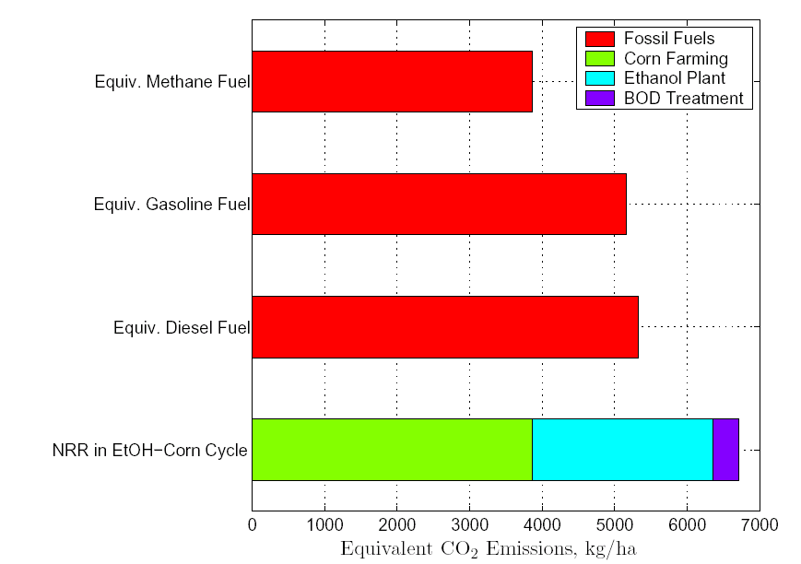
Total CO₂ emissions

Slide 21
From Summary of Renewable Fuel Options (NCEP)
“Unlike corn ethanol, cellulosic ethanol has potential to achieve near-zero net carbon emissions.
Cultivation of cellulosic feedstocks requires very low energy inputs and, if sustainably managed, the carbon released during fuel combustion is reabsorbed by the growth of new feedstocks.”

Slide 22
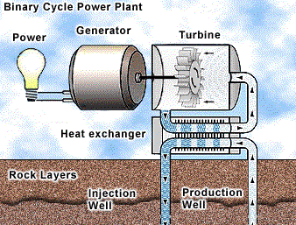
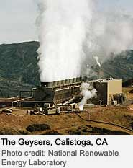
Geothermal Energy in More Details
Use heat to make steam to turn turbine for electrical generation
Note: deep hot waters are corrosive to best to inject clean water in a closed system and bring it back to the surface as steam.

Slide 23
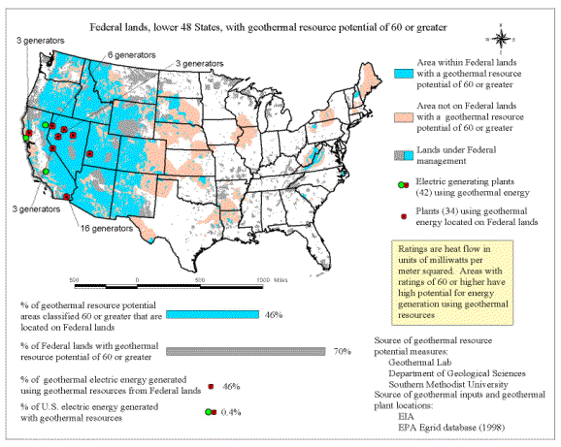
In U.S., much done on public land = cheap
Very little potential in east and mid west

Slide 24
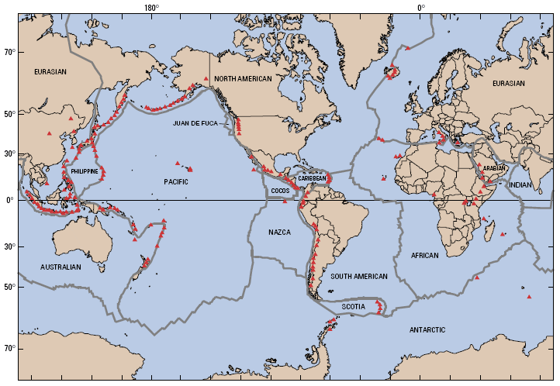
World wide distribution of volcanos, hot springs, etc.
Japan, Iceland,New Zealand big users of geothermal.

Slide 25
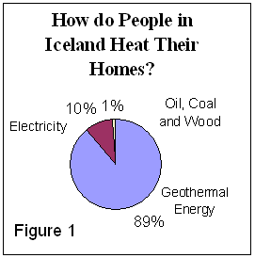

Slide 26
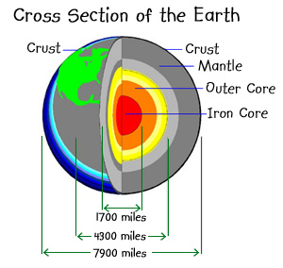
Although hot areas near surface are limited, the earth is hot everywhere if you go down far enough.

Slide 27
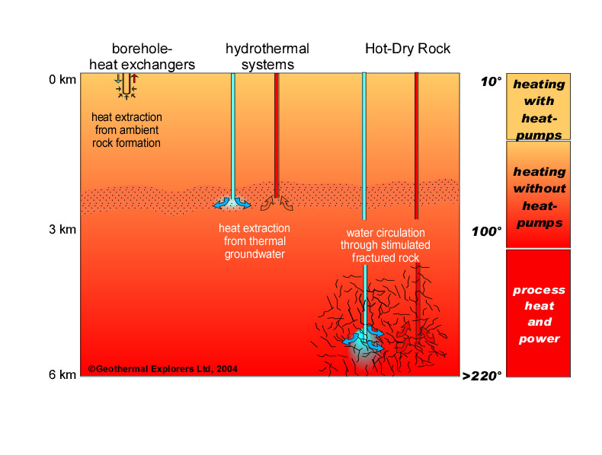
Bright idea!? – drill deep enough to find heat. Since rock is a poor conductor of heat, set off a big bomb to crack the rock and allow heat to move – then pump down water to make steam.

Slide 28
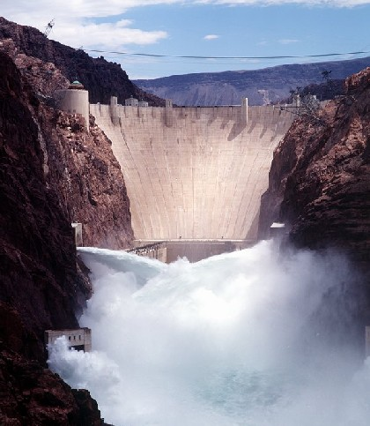
Hydropower in More Details

Slide 29
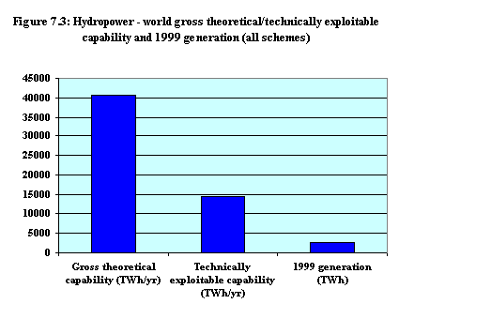
Hydropower = dams
Not much used in world, why??

Slide 30
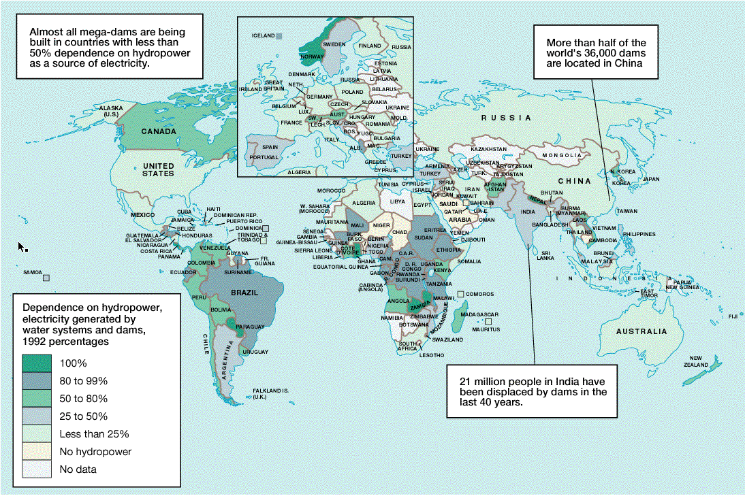
Norway, Zambia, Ghana big users

Slide 31
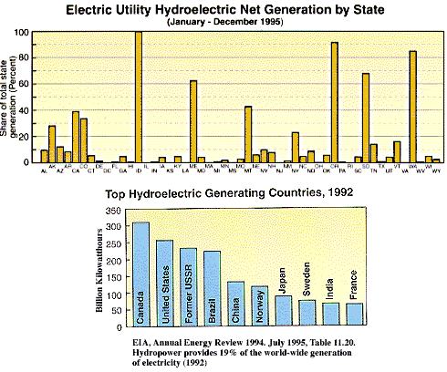

Slide 32
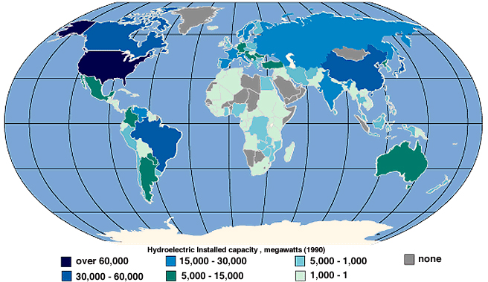
Most unused hydropower in U.S. = Alaska,
In World = Canada, Russia

Slide 33
Problems with hydroelectric
Location = unused rivers are in extreme north or low population areas
Competition with recreational uses (U.S.) and environmental concerns
Hard to build dams in populated river valleys
Siltation of dams – limited life.

Slide 34
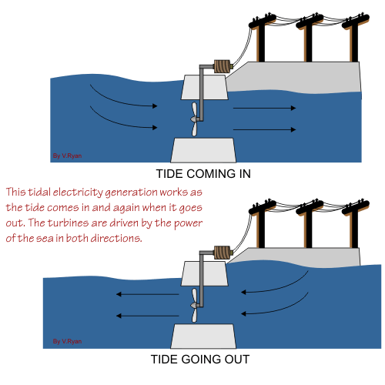
Tidal Power
In areas of large tides
Anywhere – build offshore dam

Slide 35
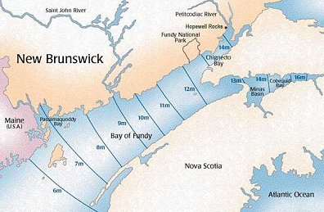
Highest tides in the world = Bay of Fundy 16 meters = 48+ feet!

Slide 36
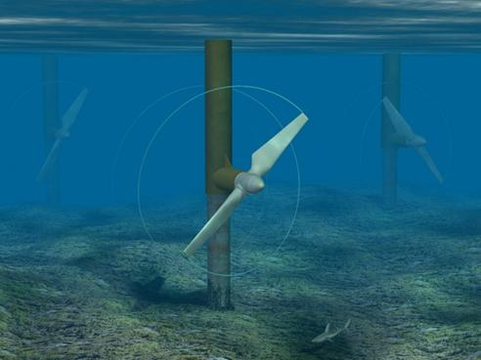
Tidal power anywhere
No dam – but a turbine.
Problems:
Corrosion
Navigation
Appearance
Amount of energy available is low
Best tides are near poles – away from people.

Slide 37
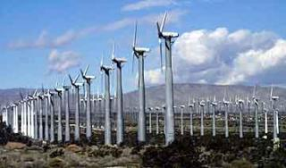
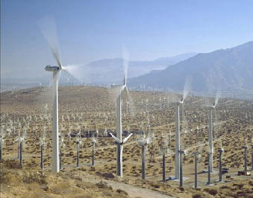
Wind Power in More Details
Banning Pass

Slide 38
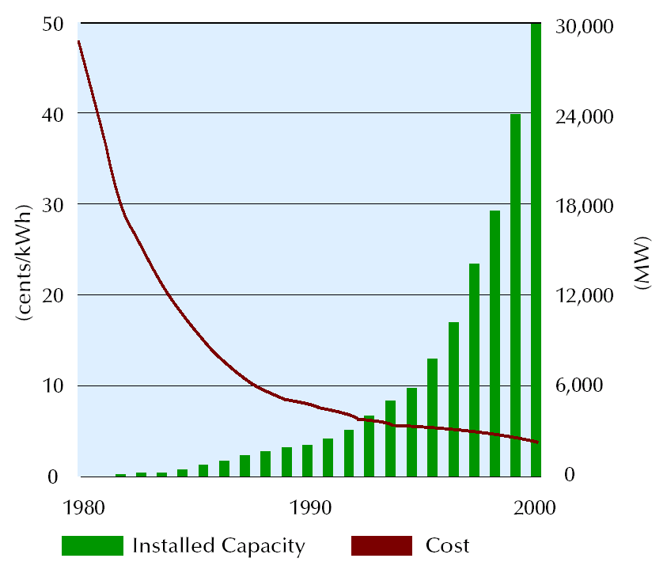
Wind Power Generation

Slide 39
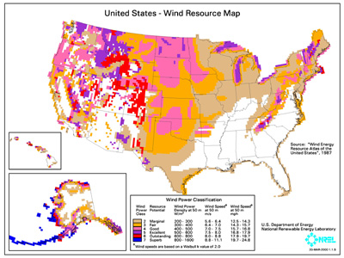
Best wind location = Aleutian Islands, why no wind development there?

Slide 40
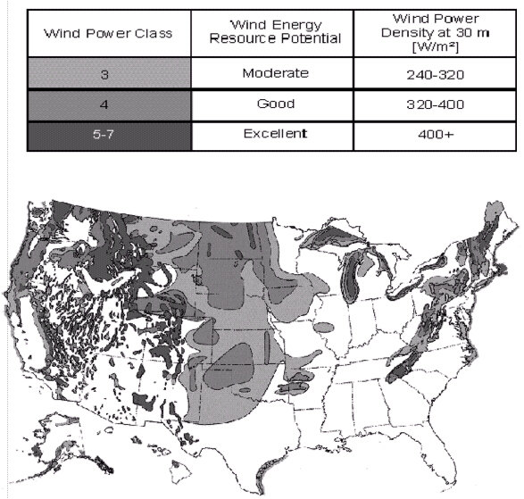
Best U.S. localities
Midwest, mountains
And coastal areas.

Slide 41
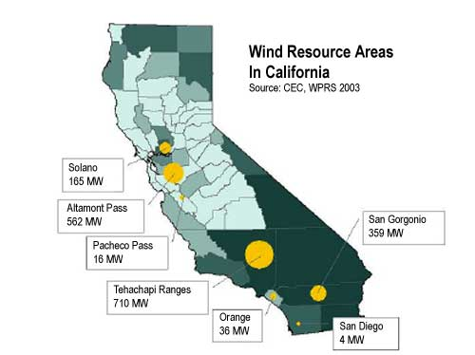

Slide 42
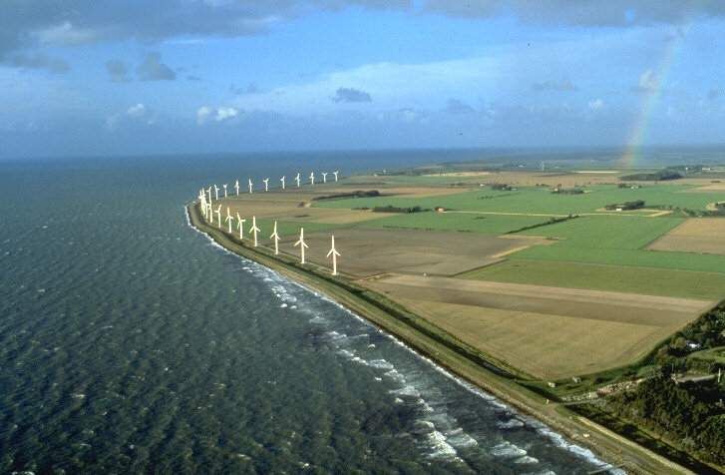
Netherlands = coastal development

Slide 43
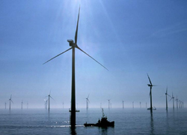
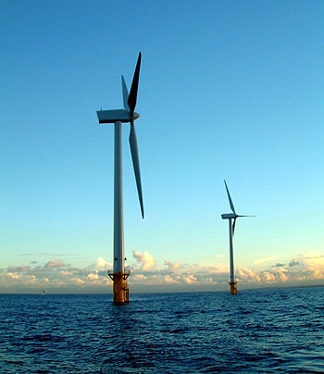
England = off shore

Slide 44
Wind energy problems
Location – near population center
Bird migration –
Visual
Must be coupled with other sources of electricity (intermittent supply)

Slide 45
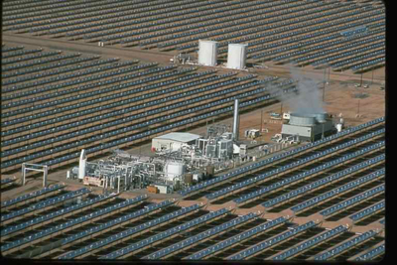
Solar Energy in More Details
1. Solar Thermal

Slide 46
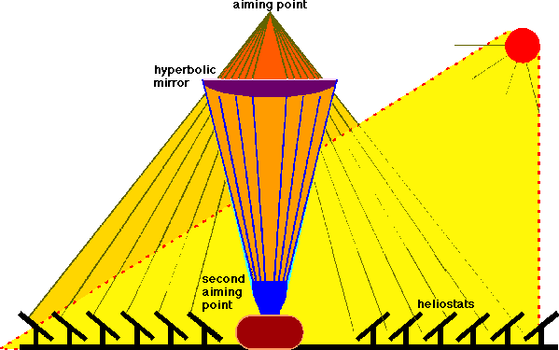
At focal point = heat liquid – steam to turn turbine

Slide 47
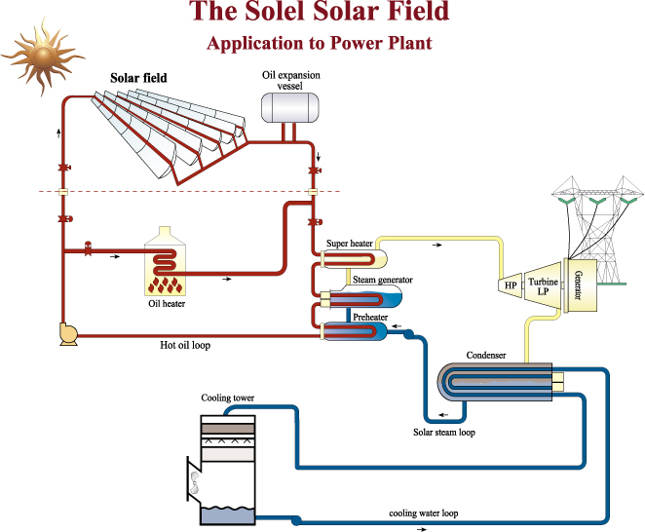

Slide 48
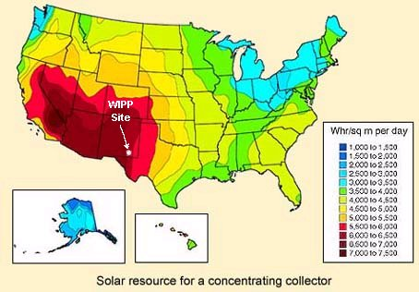
Solar Resource for a Concentrating Collector

Slide 49
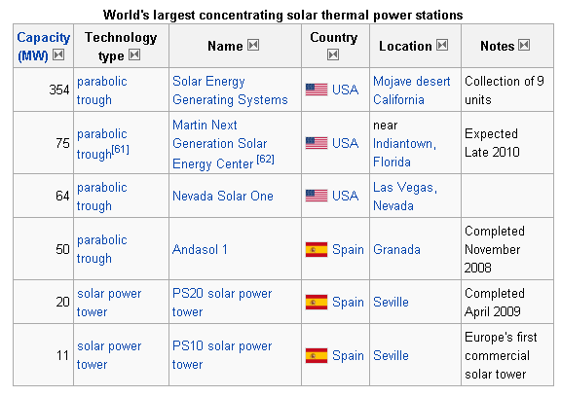
Big Plants

Slide 50
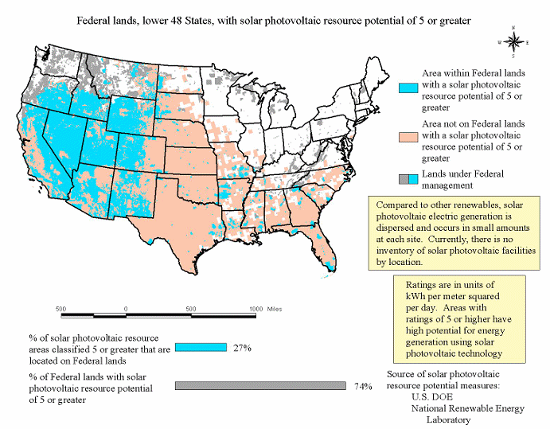
2. Solar Photovoltaics

Slide 51
‘hard’ vs ‘soft’ energy paths
Hard =
Big plants
Centralized production
Soft =
Decentralized
units per household

Slide 52
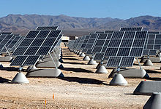
Big Plants

Slide 53
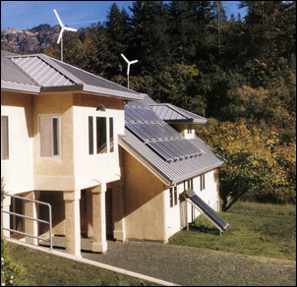
Decentralized
Energy efficient house; wind power on roof. Solar panels for heat and electricity.

Slide 54
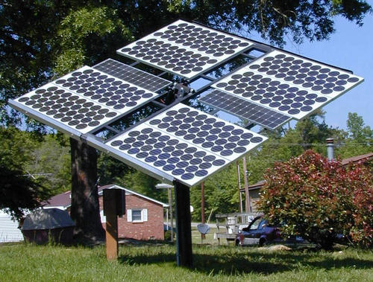
Solar electricity generation

Slide 55


Solar water heating solar air heating

Slide 56
Solar house problems
The Los Angeles air = smog
Retrofitting- very expensive
Hard for big hotels, Walmarts, etc.

Slide 57
Solar house economics
Add $16,000 to price of house
Pay back - $1500 per year in energy costs
15 years to break even
Federal tax incentive; 40% of investment can be written off. Discontinued in 1986
City of Claremont – solar energy ordinance. 60% of hot water – solar
Exceptions for equivalent savings of energy = Colleges approach. Why not trust solar?

